Slide 1
Introduction to R

Slide 2
What is R?
R is an extremely versatile open source programming language for statistics and data science.
It is widely used in every field where there is data: business, industry, government, medicine, academia, and so on.
Key Advantages:
R is free
New statistical methods are usually first implemented in R
Lots of help due to active community

Slide 3
R : Object Oriented Programming
Everything in R is an object
An object is a data structure having some attributes and methods which act on its attributes.
Class is a blueprint for the object. We can think of class like a sketch (prototype) of a house. It contains all the details about the floors, doors, windows etc. Based on these descriptions we build the house.

Slide 4
Installation
Download R
https://cran.r-project.org/bin/windows/base/
Download Rstudio
https://www.rstudio.com/products/rstudio/download/#download
Powerful IDE (Integrated Development Environment) for R
It is free and open source, and works on Windows, Mac, and Linux and over the web

Slide 5
Using R: Best Practices
Open a new or pre-existing script in RStudio(extension .R)
Save the file (for example as ‘Day1.R’)
Set working directory with setwd(“path2directory),Check your working directory with getwd()
Comment your script with # –REALLY IMPORTANT!
Write and execute your commands (with button or 'Ctrl+Enter' in Rstudio)
Output is saved in your working directory (if folder unspecified) ,Save your script ('Ctrl+S’)
Quit your session and save workspace if required
R is case sensitive

Slide 6

Path Name
Two Back Slash \\
One Forward slash /
#to set the working directory
setwd("C:\\Users\\Shanu\\ATI")

Slide 7
R : Just as Calculator
R understands the following basic operators:
+ and − for addition and subtraction
∗ and / for multiplication and division
∧ for exponents
%% is the modulo operator (remainder)

Slide 8
Variables : Building block for R
Variables are reserved memory locations to store values. This means that, when you create a variable you reserve some space in memory.
Data Type
Data Structure
Based on the data type of a variable, the operating system allocates memory and decides what can be stored in the reserved memory.
The variables are assigned with R-Objects and the data type of the R-object becomes the data type of the variable.
Logical, numeric, character, integer
Vector, Factor, List, Matrix, DataFrame
Use assignment operator ‘<- ‘ or ’=‘ to create variable

Slide 9
Data Types
Data Type | Description | Examples
Logical | Binary | TRUE/ FALSE
Numeric | Integer & Real numbers | 5, -2, 4.7,..
Integer | Whole numbers | 0, 1, 2, …
Character | Character String | “I Love India”
Complex | Complex Numbers | 2+3i
Types can be explicitly converted: as.logical(), as.numeric(), as.integer(), as.character(), as.complex()
You can check for a data type: is.logical(), is.numeric(), is.integer(), is.character(), is.complex()
To know the data type use : class()

Slide 10
Data Structure :Vector
A vector is a collection of values that all have the same data type
One-dimensional
Examples:
(-2, 3.4, 3.75, 5.2, 6)
(TRUE, FALSE, TRUE, TRUE, FALSE)
(“blue”, “green”, “red”, “red”)
You can create a vector with :
c( ) function to combine individual values

Slide 11
Type Conversion
It is important to remember that a vector can only be composed of one data type.
This means that you cannot have both a numeric and a character in the same vector.
If you attempt to do this, the lower ranking type will be coerced into the higher ranking type.
logical < integer < numeric < complex < character

Slide 12
Useful Functions
min(), max(), mean(), median(), sd(), sum(), prod(), unique(), abs()
range() : Min and Max
sort() : Decreasing -by default
length() : number of elements
summary() : Summary statistics
cumsum(), sqrt(), round()
diff() : provides difference from previous elements
table() : frequency

Slide 13
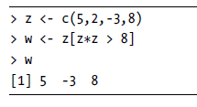

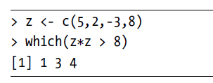
Value Filtering
Comparison
>
<
>=
<=
==
!=
Index Filtering

Slide 14
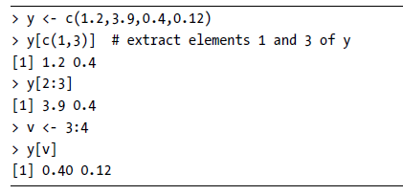
Vector Indexing
One of the most important and frequently used operations in R is that of indexing vectors, in which we form a subvector by picking elements of the given vector for specific indices.

Slide 15
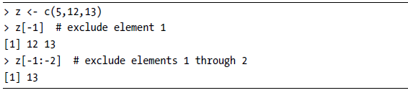
Vector Indexing
Negative subscripts mean that we want to exclude the given elements in our output.

Slide 16
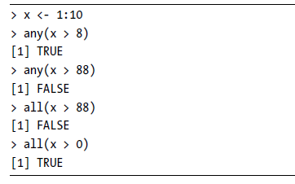
all() and any()
The any() and all() functions are handy shortcuts. They report whether any or all of their arguments are TRUE.

Slide 17
Arithmetic Operations
the +, -, /, *, %% operation will be applied element-wise
> x <- c(1,2,4)
> x + c(5,0,-1)
[1] 6 2 3

Slide 18
Recycling
When applying an operation to two vectors that requires them to be the same length, R automatically recycles, or repeats, the shorter one, until it is long enough to match the longer one.
> c(1,2,4) + c(6,0,9,20,22)
[1] 7 2 13 21 24

Slide 19
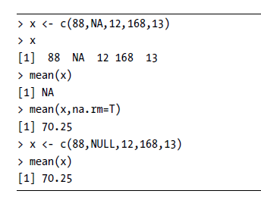
NA Values

Slide 20
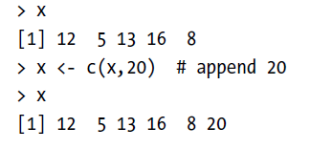
NULL values
One use of NULL is to build up vectors in loops, in which each iteration adds another element to the vector.
In this simple example, we build up a vector of even numbers:
# build up a vector of the even numbers in 1:10
> z <- NULL
for (i in 1:10) if (i %%2 == 0) z <- c(z,i)
> z
[1] 2 4 6 8 10

Slide 21
Assignment
Create sequence of number from 50 to 100.
Replace the even number with 0
Replace the number multiple of 6 by 6
Calculate the sum,and cumulative sum, average
Add c(1:10) and c(20:30), what will be the length?
Divide the c(20:100) vector by 5, then multiply by 10

Slide 22

Factors
What is a factor?
A factor is used to store categorical data
Can only contain predefined categories or levels
Can be ordered and unordered
Examples:
("yes", "no", "yes", "yes")
("male", "female", "female", "male")
("small", "large", "small", "medium")
Helpful commands :
Factors can be created using factor()
The levels of a factor can be displayed using levels()

Slide 23
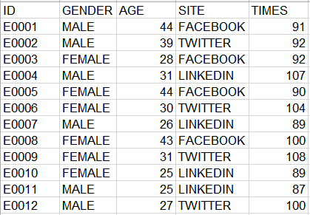
Data Frame
What is a Data frame?
• A collection of vectors that are of equal length
• Two-dimensional, arranged in rows and columns
• Columns can contain vectors of different data types
BUT : WITHIN a column, every cell must be the same type of data!

Slide 24
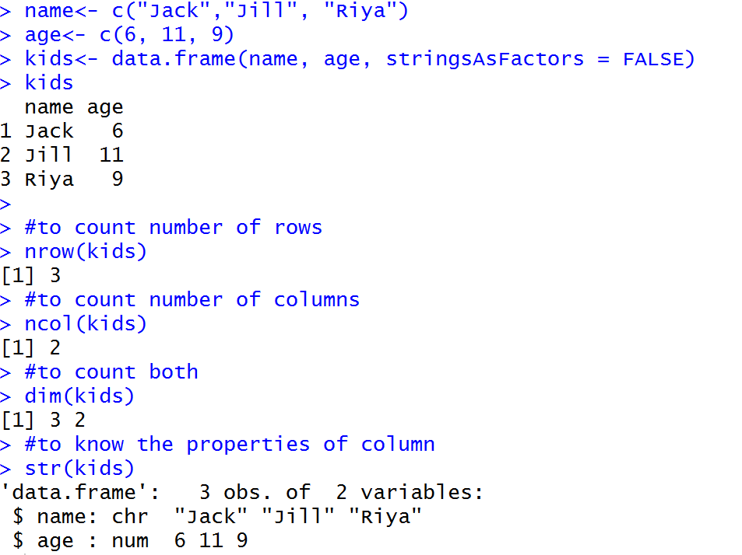
DataFrame Basics

Slide 25
Filter Elements in DataFrame
dataframe1[row index , column index]
Access using row index
dataframe1[c(1, 6,7), ]
Access using column name
dataframe1[, c(“age”)]
dataframe$age
According to row condition

Slide 26
Data Preparation
Basic workflow :
Import your data
Check, clean and prepare your data (can be up to 80% of your project)
Conduct your analyses
Export your results
Clean R environment and close session
Basic Sanity check for data :
Columns should contain variables
Rows should contain observations, measurements, cases, etc.
Use first row for the names of the variables
Enter NA (in capitals) into cells representing missing values
You should avoid names (or fields or values) that contain spaces
Store data as .csv or .txt files as those can be easily read into R

Slide 27
Import Data/ writing file
#Direct way
library(rio)
setwd("C:\\Users\\hag5kor\\Desktop\\Shanu\\ATI\\R Prerequisites (1)\\")
student_data<-import("student_data.xlsx")
print(student_data)
#to write in CSV format
export(student_data,"student1.csv")
#to write in xlsx format
export(student_data,"student1.xlsx")
#to write in txt format
export(student_data,"student1.txt")
..

Slide 28
Overview Statistics
After you read in your data, you can briefly check it with some useful commands:
summary() provides summary statistics for each variable
names() returns the column names
str()gives overall structure of your data
head() returns the first lines (default: 6) of the file and the header
tail() returns the last lines of the file and the header
Now we will look at a few common things to look out for !!

Slide 29
Data Manipulation : Dplyr
The package contains a set of functions that perform common data manipulation operations such as filtering for rows, selecting specific columns, re-ordering rows, adding new columns and summarizing data.
Some of the most important functions in the package are
select() –select columns
filter() –filter rows
mutate() –add columns
arrange() –arrange rows
summarise() – summarise values
group_by() –Allows groups operations

Slide 30
Naming Convention
Variable and function names should be lowercase.
Use an underscore (_) to separate words within a name.
Variable/File names should be meaningful

Slide 31
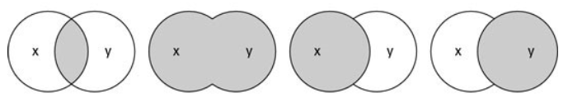
Data Frame Joining
Inner Join
Full Join
Left Join
Right Join
inner_join()
full_join()
left_join()
right_join()

Slide 32
Missing value treatment
#To create Data Frame
name<- c("Jack","Jack","Jill","Jill", "Riya","Ram")
age<- c(6,6, 11, 9,10, NA)
weight<- c(17,17, NA, 20,30, 80)
kids<- data.frame(name, age,weight, stringsAsFactors = FALSE)
kids
#to count number of NA's/ missing value
sum(is.na(kids))
#To remove all rows contains NA
kids[complete.cases(kids), ]
#to remove row if age column contains NA
kids[!(is.na(kids$age)),]
#replace NA value in age column with mean age
kids[is.na(kids$age), 'age'] = mean(kids$age, na.rm= TRUE)
kids

Slide 33
Duplicate values
#To remove duplicates from data
kids[!duplicated(kids),]
#to know the duplicate rows
kids[duplicated(kids),]
#to remove duplicate from particular column
kids[!duplicated(kids$name),]

Slide 34
Date Conversion
library(lubridate)
t1<-"2011-06-04 12:00:00"
ymd_hms(t1)
#To increase date by year, month, day
x+ years(1)
x+ months(12)
x+ days(1)
#to find the week day
wday(x, label = TRUE)

Slide 35
Plotting in R
library(ggplot2)
data("iris")
#Scatter Plot
ggplot(iris, aes(x=Sepal.Length,y= Sepal.Width, color=Species ))+ geom_point()
#line chart
ggplot(mtcars, aes(x=mpg, y= hp , color=as.factor(gear)))+ geom_line()
#Bar chart
ggplot(mtcars, aes(x = gear)) + geom_bar()
#Histogram
ggplot(mtcars, aes(x = disp)) +
geom_histogram(fill="green")

Slide 36
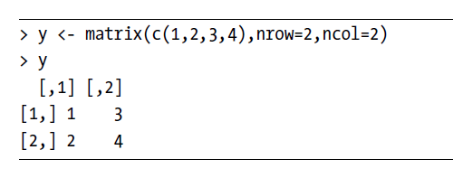
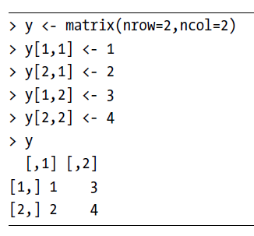
Matrix
A matrix is a vector with two additional attributes: the number of rows and the number of columns.
Can store one data type at a time

Slide 37
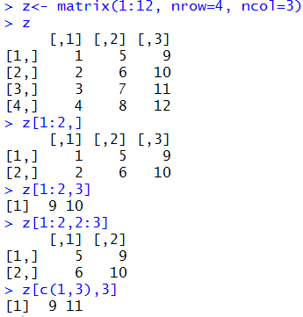
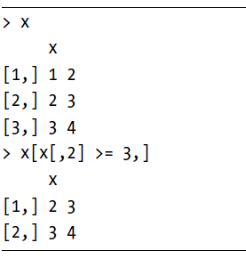
Filtering on Matrices

Slide 38
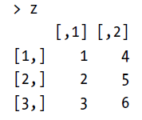

Functions to Matrix Rows and Columns
apply(m, dimcode, f, fargs)
where the arguments are as follows:
m is the matrix.
dimcode is the dimension, equal to 1 if the function applies to rows or 2 for columns.
f is the function to be applied.
fargs is an optional set of arguments to be supplied to f.

Slide 39
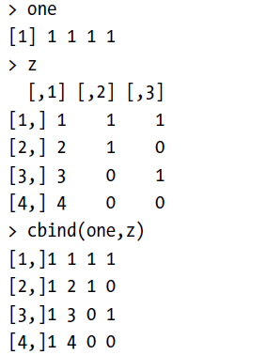
Addition of new Row/Column
The rbind() (row bind) and cbind() (column bind) functions let you add rows or columns to a matrix.
nrow()
ncol()
dim()

Slide 40
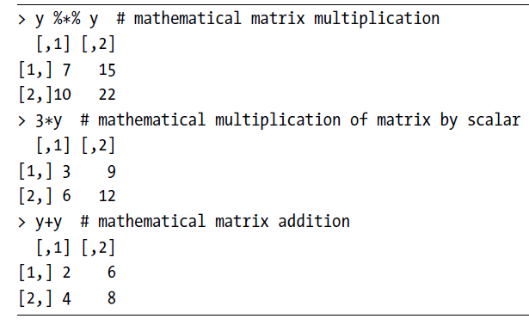
Algebra Operations on Matrices

Slide 41

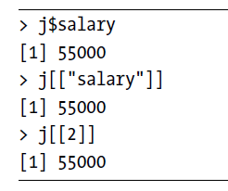
List
In contrast to a vector, in which all elements must be of the same mode, R’s list structure can combine objects of different types.
A list can encompass any data types, including lists
Objects can have different lengths
Almost all functions (e.g., t-test, linear regression, etc.) in R produce output that is stored in a list
Indexing
List<-list(1:3,c("a","b"),c(TRUE,FALSE,TRUE))

Slide 42
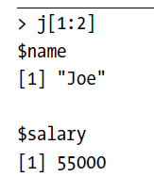
List Indexing
If single brackets [ ] are used, the result is another list-a sublist of the original.
use double brackets [[ ]] for referencing only a single component

Slide 43
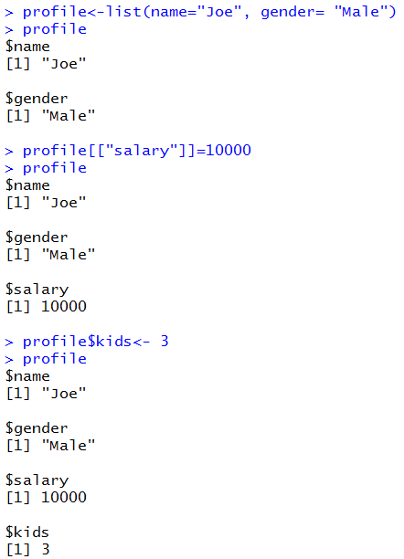
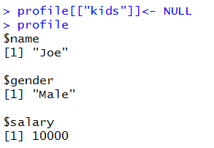
Adding and Deleting List Elements
You can delete a list component by setting it to NULL.
names(profile)

Slide 44
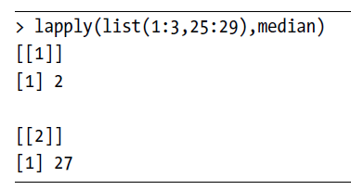

Applying Functions to Lists
The function lapply() (for list apply) works like the matrix apply() function, calling the specified function on each component of a list and returning another list.
To return in vector format use sapply() (simplified [l]apply)
List to Vector : unlist()
Monthly Sales in supermarket

Slide 45
Conditional Statements
if(), else() and ifelse()
Syntax:
if ( condition ) { commands1 }
if ( condition ) { commands1 } else { commands2 }
ifelse( conditions vector, yes vector, no vector )
These are conditional statements that are executed based on one or multiple conditions.
Example:
x <-4
if (x==5) {x <-x+1} else {x <-x*2} What is the response ??
y <-1:10
z <-ifelse( y<6, y^2, y-1 ) What is the response ??

Slide 46
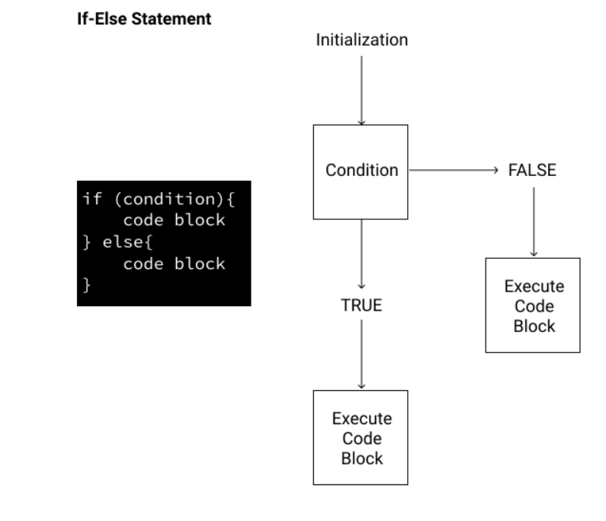

Slide 47
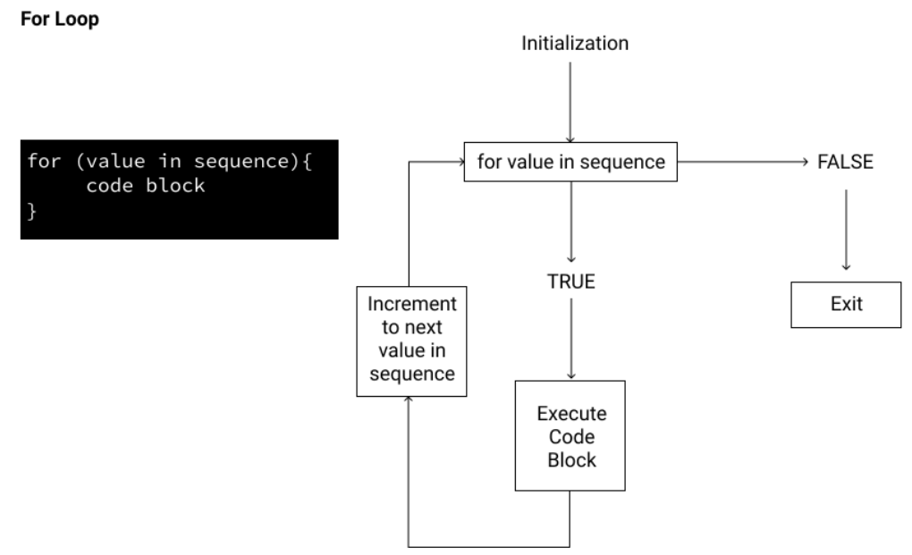
Loops

Slide 48
Example Use case
Problem : To provide advice to client on how to improve sales of a particular product.
Data : The Advertising data set consists of the sales of that product in 200 different markets, along with advertising budgets for the product in each of those markets for three different media: TV, radio, and newspaper.
Understanding:
It is not possible for our client to directly increase sales of the product. On the other hand, they can control the advertising expenditure in each of the three media.
Therefore, if we determine that there is an association between advertising and sales, then we can instruct our client to adjust advertising budgets, thereby indirectly increasing sales.
Advertising budgets are input variables while sales input is an output variable.
on the basis of this data, a marketing plan for next year that will result in high product sales.
Notes:
In other words, our goal is to develop an accurate model that can be used to predict sales on the basis of the three media budgets. Advertising budgets are input variables while sales input is an output variable.

Slide 49
Questions
Is there a relationship between advertising budget and sales?
How strong is the relationship between advertising budget and sales?
Which media contribute to sales? Do all three media—TV, radio, and newspaper—contribute to sales, or do just one or two of the media contribute?
How accurately can we estimate the effect of each medium on sales?
For every dollar spent on advertising in a particular medium, by what amount will sales increase?
How accurately can we predict future sales?
For any given level of television, radio, or newspaper advertising, what is our prediction for sales, and what is the accuracy of this prediction?

Slide 50
Questions
Is the relationship linear?
If there is approximately a straight-line relationship between advertising expenditure in the various media and sales, then linear regression is an appropriate tool.
If not, then it may still be possible to transform the predictor or the response so that linear regression can be used.
Is there synergy among the advertising media?
Perhaps spending $50,000 on television advertising and $50,000 on radio advertising results in more sales than allocating $100,000 to either television or radio individually.
In marketing, this is known as a synergy effect, while in statistics it is called an interaction effect.
We can use linear regression to answer each of these questions.

Slide 51
Count Even numbers in vector
x <- c(2,5,3,9,8,11,6)
count <- 0
for (val in x)
{
if(val %% 2 == 0)
count = count+1
}
print(count)

Slide 52
Assignment
Suppose x= 1:20, either multiplied by 2 or 3, depending on whether the element is greater than 6.
An abalone data set, c(‘M’, ‘F’, ‘F’,’I’,’M’,’M’,’F’) gender is coded as M, F, or I (for infant). We wish to recode those characters as 1, 2, or 3.
Subgroups according to gender.
Create the following matrices
Define a new matrix m by m <-matrix( 11:35, nrow=5, byrow=TRUE )
What is the entry in the third row and forth column?
Define a new submatrix sub that contains the elements of rows 2 to 4 and columns 3 to 5.

Slide 53
Assignment
Define the list myList as myList<-list(1:6, c("a", "b"), c(FALSE, TRUE, TRUE)
What is the element with index 2 in myList?
Which type of data is the element with index 3 in myList

Slide 54
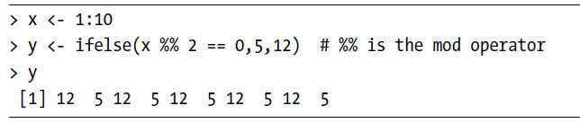
We wish to produce a vector in which there is a 5 wherever x is
even or a 12 wherever x is odd.

Slide 55
Thank You

Slide 56
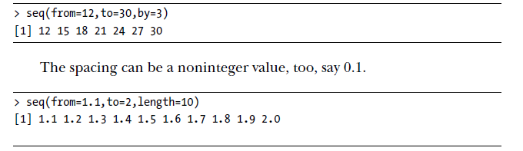
Generate Sequence
A generalization of : is the seq() (or sequence) function, which generates a sequence

Slide 57
Repeat
The rep() (or repeat) function allows us to conveniently put the same constant into long vectors.
To create replicates of values
rep(1:4, each = 2, times = 3)

